Slide 1
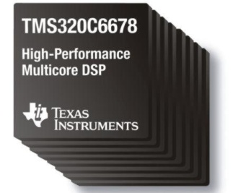
Intro to: Inter-Processor Communications (IPC)
Chapter x
C66x Embedded Design Workshop
Copyright © 2012 Texas Instruments. All rights reserved.
1

Slide 2
Objectives
Describe the basic concepts of IPC.
Compare and contrast different services provided within the IPC framework.
Analyze several support utilities.
Describe the setup configuration required to use the IPC framework.
Examine a few IPC examples.
2

Slide 3
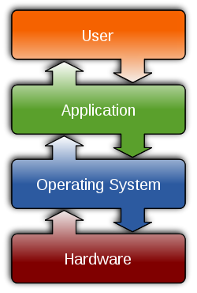

Outline
Basic Concepts
IPC Services
Setup and Examples
IPC Transports
Lab or Demo

Slide 4
IPC – Definition
IPC = Inter-Processor Communication
While this definition is rather generic, it really means:
“Transporting data and/or signals between threads of execution”
These threads could be located anywhere:
Thread 1
Data
Thread 2
CorePac 0
CorePac 0
Device 0
CorePac 0
CorePac 1
Device 1
How would YOU solve this problem?
4

Slide 5
IPC – Possible Solutions
How do you transport the data and signal?
Manual: Using shared memory and an INT (possible contention)
Auto: Using existing RTOS/Framework Utilities (i.e. IPC)
Thread 1
Data
Thread 2
CorePac 0
CorePac 0
Device 0
CorePac 0
CorePac 1
Device 1
What solutions exist in TI’s RTOS to perform IPC ?
5

Slide 6
IPC – RTOS/Framework Solutions
SAME CorePac: TI’s RTOS (SYS/BIOS) supports several services for inter-thread communication (e.g. semaphores, queues, mailboxes, etc.).
DIFFERENT CorePac: The IPC framework supports communications between CorePacs via several transports.
DIFFERENT DEVICE: IPC transports can also be implemented between devices.
KEY: Same IPC APIs can be used for local or remote communications.
Thread 1
Data
Thread 2
Solutions
SYS/BIOS (or IPC)
IPC + transport
IPC + transport
CorePac 0
CorePac 0
Device 0
CorePac 0
CorePac 1
Device 1
What kinds of transports are possible ?
6

Slide 7
IPC – Transports
IPC supports several transports:
CorePac → CorePac (Shared Memory Model, Multicore Navigator)
Device → Device (Serial Rapid I/O)
Chosen at configuration; Same code regardless of location
Device 1
Device 2
CorePac 1
CorePac 2
CorePac 1
Thread 1
Thread 2
Thread 1
Thread 2
Thread 1
Thread 2
IPC
IPC
IPC
MEM
or
Multicore Navigator
SRIO
SRIO
What services does IPC provide?
7

Slide 8
Outline
Basic Concepts
IPC Services
Notify
Data Passing
Message Queue
Support Utilities
Setup and Examples
IPC Transports
Lab or Demo

Slide 9
IPC Services – Introduction
The IPC Package is a library that contains many user services:
Transport – Shared Memory
SIMPLE – Data Passing + Notify Send a 32-bit message and notify via INT
STATIC – Data Passing via Linked Lists + Notify Pass linked list elements to/from fixed memory. Notify via INT.
DYNAMIC – Data Passing via Heaps + Notify Pass dynamically created linked list elements. Notify via INT.
Multiple Transport – Shared Mem, Multicore Navigator, SRIO
MESSAGE QUEUE – the ultimate IPC capability Configure transport, use simple APIs to send MSGs + notify
Let’s examine how a simple NOTIFY works first…
9

Slide 10
Outline
Basic Concepts
IPC Services
Notify
Data Passing
Message Queue
Support Utilities
Setup and Examples
IPC Transports
Lab or Demo

Slide 11
Using Notify – Concepts
Notify is the SIMPLEST form of IPC communication.
Use: Send simple 32-bit payload to another CorePac.
Sender: Transmit payload and eventId (INT) to destination CorePac.
Receiver: Receive payload/eventId and run associated callback fxn.
Device 1
CorePac 1
CorePac 2
Thread 1
Thread 2
Thread 1
Thread 2
IPC
IPC
MEM
Let's see an example...
11

Slide 12
Using Notify – Example
Notify APIs interact with IPC Notify module.
Configuration is done via the IPC MultiProc module.
Notify manager handles multiple interrupt events via single INT line.
User APIs
Notify
Uses
MultiProc
// SENDER
Void Notify_sendEvent(dstId, lineId, eventId, payload, waitClear);
// RECEIVER
Void Notify_registerEvent(srcId, lineId, eventId, cbFxn, cbArg);
When RECEIVER gets this eventId from the SENDER, the cbFxn is called and passes the srcId, eventId, payload and cbArg.
12

Slide 13
Example Callback Function
/*
* ======== cbFxn ========
* This fxn was registered with Notify. It is called when any event is sent to this CPU.
*/
void cbFxn(UInt16 procId, UInt16 lineId, UInt32 eventId, UArg arg, UInt32 payload)
{
/* The payload is a sequence number. */
recvProcId = procId;
seq = payload;
Semaphore_post(semHandle);
}

Slide 14
Outline
Basic Concepts
IPC Services
Notify
Data Passing
Message Queue
Support Utilities
Setup and Examples
IPC Transports
Lab or Demo

Slide 15
Data Passing – Concepts
Uses double linked lists to share data between CorePacs
Use: Send more complex data elements to another CorePac.
Linked lists can be configured statically or dynamically.
Not typically used by itself – but as a building block for MessageQ
Device 1
CorePac 1
CorePac 2
Thread 1
Thread 2
Thread 1
Thread 2
IPC
IPC
MEM
Let’s look at the static version first…
15

Slide 16
Data Passing – Static
Data Passing uses a double linked list that can be shared between CorePacs; Linked list is defined STATICALLY.
ListMP handles address translation and cache coherency.
GateMP protects read/write accesses.
ListMP is typically used by MessageQ (covered later), not by itself.
User APIs
Notify
ListMP
Uses
MultiProc
Uses
Shared Region
Cfg
GateMP
NameServer
Now, the dynamic version...
16

Slide 17
Data Passing – Dynamic
Data Passing uses a double linked list that can be shared between CPUs. Linked list is defined DYNAMICALLY (via heap).
Same as previous, except linked lists are allocated from Heap
Typically not used alone – but as a building block for MessageQ
User APIs
Notify
ListMP
HeapMemMP +
Uses
MultiProc
Uses
Shared Region
Uses
Cfg
GateMP
NameServer
And last...let's look at MessageQ...
17

Slide 18
Outline
Basic Concepts
IPC Services
Notify
Data Passing
Message Queue
Support Utilities
Setup and Examples
IPC Transports
Lab or Demo

Slide 19
MessageQ – Concepts
Supports structured sending/receiving of variable-length messages
Default “transport” is shared memory, but other transports (Multicore Navigator, SRIO) can be configured.
APIs do NOT change based on transport – only the CFG (init) code
Supports SINGLE reader, multiple WRITER (READER owns mailbox)
Device 1
Device 2
CorePac 1
CorePac 2
CorePac 1
Thread 1
Thread 2
Thread 1
Thread 2
Thread 1
Thread 2
IPC
IPC
IPC
MEM
or
Multicore Navigator
SRIO
SRIO
Let's see an example...
19

Slide 20
Using MessageQ (1/4)
CorePac 2 - READER
MessageQ_create(“myQ”, …);
MessageQ_get(“myQ”, &msg…);
“myQ”
MessageQ transactions begin with READER creating a MessageQ.
READER’s attempt to get a message results in a block (when semaphore specified), since no messages are in the queue yet.
What happens next?
20

Slide 21
Using MessageQ (2/4)
CorePac 1 - WRITER
CorePac 2 - READER
MessageQ_open (“myQ”, …);
msg = MessageQ_alloc (heap, size,…);
MessageQ_put(“myQ”, msg, …);
MessageQ_create(“myQ”, …);
MessageQ_get(“myQ”, &msg…);
“myQ”
Heap
WRITER begins by opening MessageQ created by READER.
WRITER gets a message block from a heap and fills it, as desired.
WRITER puts the message into the MessageQ.
How does the READER get unblocked?
21

Slide 22
Using MessageQ (3/4)
CorePac 1 - WRITER
CorePac 2 - READER
MessageQ_open (“myQ”, …);
msg = MessageQ_alloc (heap, size,…);
MessageQ_put(“myQ”, msg, …);
MessageQ_close(“myQ”, …);
MessageQ_create(“myQ”, …);
MessageQ_get(“myQ”, &msg…);
*** PROCESS MSG ***
MessageQ_free(“myQ”, …);
MessageQ_delete(“myQ”, …);
“myQ”
Heap
Once WRITER puts msg in MessageQ, READER is unblocked.
READER can now read/evaluate the received message.
READER frees message back to Heap.
READER can optionally delete the created MessageQ, if desired.
22

Slide 23
Using MessageQ (4/4)
CorePac 1 - WRITER
CorePac 2 - READER
MessageQ_open (“myQ”, …);
msg = MessageQ_alloc (heap, size,…);
MessageQ_put(“myQ”, msg, …);
MessageQ_close(“myQ”, …);
MessageQ_create(“myQ”, …);
MessageQ_get(“myQ”, &msg…);
*** PROCESS MSG ***
MessageQ_free(“myQ”, …);
MessageQ_delete(“myQ”, …);
“myQ”
Heap
The message object manages queuing of messages passed.
An ALLOCATOR mechanism gets the buffers (standard is HeapMemMP).
A TRANSPORT mechanism can be specified during init (default is shared memory, but can also use Multicore Navigator or SRIO).
Which IPC modules does MessageQ use?
23

Slide 24
MessageQ – Configuration
All API calls use the MessageQ module in IPC.
User must also configure MultiProc and SharedRegion modules.
All other configuration/setup is performed by MessageQ.
User APIs
MessageQ
Notify
ListMP
HeapMemMP +
Uses
MultiProc
Uses
Shared Region
Uses
Cfg
GateMP
NameServer
Some final notes on MessageQ...
24

Slide 25
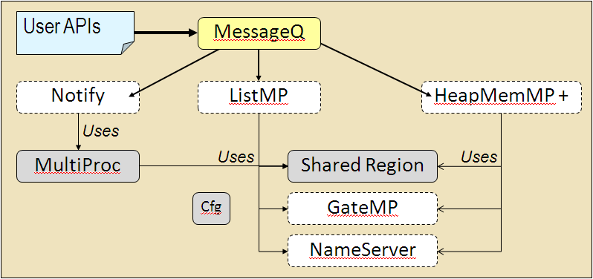
MessageQ – Miscellaneous Notes
O/S independent; If one CorePac is running LINUX and using SYS/Link, the API calls do not change.
Messages can be allocated statically or dynamically.
Works with all threading modules (HWI, SWI, Task)
Can synchronize via semaphores, SWIs, events, wait
Timeouts are allowed when Tasks receives message.
User can specify three priority levels (normal, high, urgent).
25

Slide 26
Outline
Basic Concepts
IPC Services
Notify
Data Passing
Message Queue
Support Utilities
Setup and Examples
IPC Transports
Lab or Demo

Slide 27
IPC Support Utilities (1/2)
IPC contains several utilities, most of which do NOT need to be configured by the user.
Here is a short description of each IPC utility:
IPC
Initializes IPC subsystems
All applications that use IPC must call IPC_start()
setupNotify and setupMessageQ specify whether to set up these IPC modules
MultiProc
Lightweight module that simply stores processor IDs
SharedRegion
Manages shared memory using HeapMemMP allocator
Handles address translation for shared memory regions
More utilities…
27

Slide 28
IPC Support Utilities (2/2)
IPC contains several utilities, most of which do NOT need to be configured by the user.
Here is a short description of each IPC utility:
ListMP
Provides linked list in shared memory
Uses multi-processor gate (GateMP) to prevent collisions on lists
GateMP
Multi-processor gate that provides local (against other threads on local core) and remote context protection
HeapMemMP
Traditional heap; Supports variable-sized alloc/free
All allocations are aligned on cache line boundaries
28

Slide 29
Outline
Basic Concepts
IPC Services
Setup and Examples
IPC Transports
Lab or Demo

Slide 30
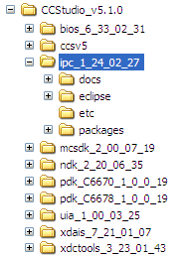
IPC – Tools/Setup Required
IPC is a package (library) that is installed with the MCSDK.
IPC also requires SYS/BIOS (threading) and XDC tools (packaging) – installed with the MCSDK (supported by SYS/BIOS ROV and RTA).
IPC will run on the latest TI multicore devices (C667x, C665x), as well as C647x and ARM+DSP devices.
Users can either install these packages separately or via the MCSDK install.
What IPC examples exist in the MCSDK?
30

Slide 31
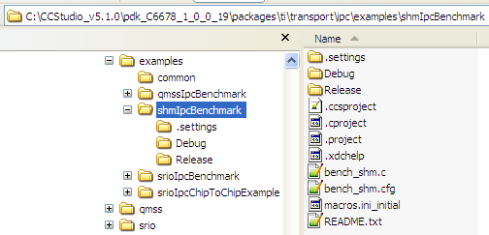
IPC – Examples
IPC examples are installed along with the MCSDK in the PDK folder.
Simply import these projects into CCS and analyze them.
Some users start with this example code and modify as necessary.
QMSS – Multicore Navigator (Queue Manager Subsystem)
SHM – Shared Memory
SRIO – SRIO (loopback)
SRIO – Chip to Chip
31

Slide 32
Outline
Basic Concepts
IPC Services
Setup and Examples
IPC Transports
Lab or Demo

Slide 33
IPC Transports – Intro
An IPC TRANSPORT is a …
“combination of physical H/W and driver code that allows two threads to communicate on the same device or across devices.”
IPC supports three different transports:
Shared Memory
This is the default transport.
Uses on-chip shared memory resources and interrupt lines to signal the availability of data
Multicore Navigator
Available on C667x and C665x processors
Uses queues and descriptors plus built-in signaling to transmit/receive “packets” or msgs between threads
SRIO
Hardware serial peripheral that connects two or more DEVICES together
For MessageQ, only the configuration (init) code changes. All other code (e.g. put/get) remains unchanged.
Let's look briefly at the Multicore Navigator first...
33

Slide 34
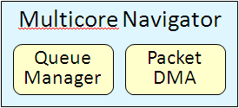
IPC Transports – Multicore Navigator
The Multicore Navigator is an innovative packet-based infrastructure that facilitates data movement and multicore control.
Provides a highly efficient inter-core communication mechanism. H/W queues and packet DMA are the basic building blocks for IPC.
Refer to the MCSDK examples for required init/CFG code.
TX Core
RX Core
msg = MessageQ_alloc
“got the pointer to Msg”
MessageQ_put
TransportShmNotify_put
MessageQ_get
NotifyQmss_sendEvent
QMSS-received descriptor
Get a descriptor
NotifyDriverQmss_isr
Attach ptr/msg to descriptor
NotifyQmss_sendEvent
(put descriptor directly in the remote core’s RxQueue)
34

Slide 35
IPC Transports –SRIO
The SRIO transport enables MessageQ to send data between tasks, cores and devices via the SRIO IP block.
Refer to the MCSDK examples for setup code required to use MessageQ over this transport.
Chip V CorePac W
Chip X CorePac Y
msg = MessageQ_alloc
“got Msg from queue”
MessageQ_put(queueId, msg)
MessageQ_get(queueHndl,rxMsg)
TransportSrio_put
MessageQ_put(queueId, rxMsg)
Srio_sockSend(pkt, dstAddr)
TransportSrio_isr
SRIO x4
SRIO x4
35

Slide 36
Outline
Basic Concepts
IPC Services
Setup and Examples
IPC Transports
Lab or Demo

Slide 37
ti
39

Slide 38
User/Application Modules
Ipc, ListMP, GateMP, Notify
Ipc: Used to initialize IPC (shared memory, gates, notifications, etc) and attach to remote processors and synchronize with them at run-time
ListMP: shared memory doubly-linked list
GateMP: multiple-processor mutex
Notify: inter-processor notifications
HeapMemMP, HeapBufMP, HeapMultiBufMP
Shared memory allocator that can be used by multiple threads on multiple processors
Flexible and/or deterministic memory management
MessageQ
Portable message passing between threads on same or different cores
Transport-independent – local, shared memory, SRIO, etc.
40

Slide 39
Outline
MainHighlight
MainNormal
SubHighlight
SubNormal

